Slide 1
Impact of EU CO2 trading scheme on energy sector The comparison of Austria and Czech Republic
Tomáš Smejkal
Teresa Kallsperger

Slide 2
EU Emission Trading Scheme
Aims:
- achieving reductive aims of Kyoto
- framework for being able to trade carbon
- creating an artificial market for trading carbon
Currency: EUA
Three periods: 2005- 2007
2008- 2012
after 2013

Slide 3
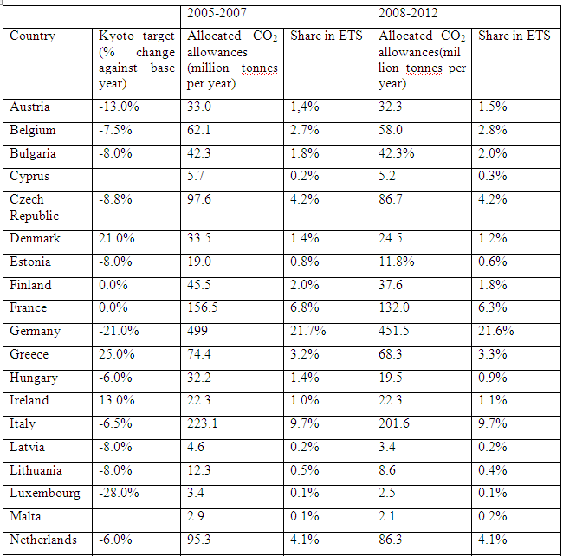
ETS Allowances per country

Slide 4
Situation in Austria
EZG as law of emission certificates
Distributing certificates:
- technical potential
- environmentally friendly technologies
- consistency with other political aims

Slide 5
National Allocation Plans (NAP)
First NAP:
- past emissions from 1998- 2004
- reduction potential for future: National Climate Strategy
- target: reduction of 1,65 mio. tons of carbon from enery and industry sector
- 99 mio. certificates, free distribution
- one percent kept for new participants
Second NAP:
- reduction about 0,55 mio. certificats per year

Slide 6
National Allocation Plans 2
- past emissions from 1998- 2004
- reduction potential for future: National Climate Strategy
- target: reduction of 1,65 mio. tons of carbon from enery and industry sector
- 99 mio. certificates, free distribution
- one percent kept for new participants

Slide 7
Allocation and trading options
Auctioning in second period
Climex
First auction in Austria 2009
Trading options:
- directly with other holders
- stock exchange: Exaa Graz

Slide 8
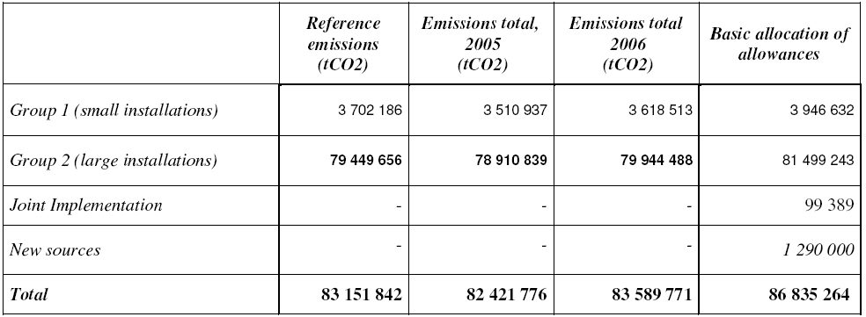
Situation in Czech Republic
Second period: 86 835 264 allowances per year
Reserve for new participants
No stock exchange

Slide 9
Comparison AT – CZ energy mix
Figure : Comparison CO₂ per capita 1992-2007

Slide 10
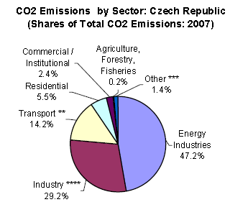
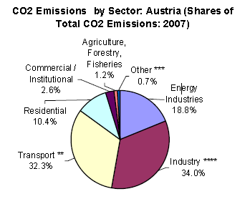
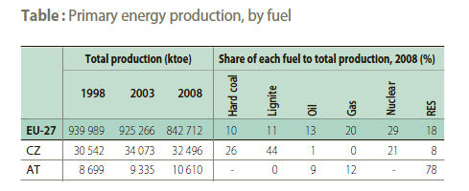
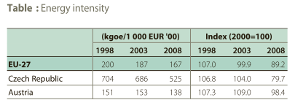

Slide 12
Impact of EU ETS?
Pricing carbon => higher cost for power producers
Windfall profits
Cost pass through rate
Impact on other sectors? Cost sharing?

Slide 13
Windfall profits
Unexpected consequence of EU ETS
PP in grandfather phases has increased prices and consequently profits
CZ: 8,7 mil. tones of CO₂-equ unused => 130 mil. € profit
Only part of windfall profit!
„They should be punished for CO2 emission“ …or not?

Slide 15
Is cost transferring economically rational?
Yes
Even if allowances are allocated freely –they are still connected with opp. costs
Is it possible because of lack of competition?
Not mainly
Main factor is elasticity of demand and supply, even in competitive market these profits are possible – monopoly can even impose lower price increase!
Is higher power prices helping to reach main aims?
Yes
Higher prices cause that consumers will relocate their spending
Notes:
In Czech Republic elasticity of demand for energy is bigger comapare to Austria, which is connected with energy intensity ect.

Slide 16
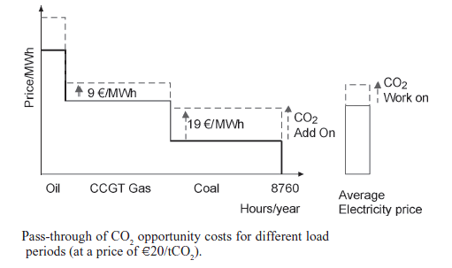
Pass through rate
How much costs will be transmitted through electricity price?
Price driver – marginal unit (depends on fuel)
In CZ – in 2005 close to 0,9
Notes:
Electricity market is somewhat specific in that way that in certain load period price is affected only by increase of marginal unit. During peak hours the price is created by marginal product of particular generator which decision making relies crucially on development of underlying fuel driver

Slide 17
Conclusions
„Windfall profits are highest in countries that have a high level of pass-through of CO₂ costs into wholesale power prices, countries with emissions intensive (coal) plant setting the price the majority of the time, and countries that allocate the highest percentage of free allowances to the power sector.“
Czech Republic will be effected significantly more than Austria by entering auction phase
PTR is higher in CZ, big change facing full auction system in CZ (overallocation do not persuade much to comply with BAT)
Bigger emission decrease in CZ
AT – industry is less dependent on power input, CZ will probably face double impact in power intensive sectors
Loss of competitiveness in these sectors are uncertain => Porter hyphothesis

Slide 18
Bigger PTR in CZ is not caused mainly by less competition, but by lower elasticity of demand in sector
First and second phases were not such a big success
All investment connected with new cleaner technology will be passed in peak hours
Strong correlation between EUA price and price of electricity

Slide 19
Sources
EU Energy in Figures 2010 : CO2 Emissions by Sector. European Commission : Directorate-General for Energy and Transport. 2010, 1, s. 1-69. Available from WWW: <http://ec.europa.eu>.
EU ETS Phase II – The potential and scale of windfall profits in the power sector. 2008, A report for WWF: Point Carbon Advisory Services. pp. 1-29.
European Union Emissions Trading System (EU ETS) data, European Environment Agency. Available from WWW: http://dataservice.eea.europa.eu
NAP Czech Republic. Available from WWW: http://www.mzp.cz/
PORTER M.E. 1991, America’s Green Strategy. Scientific American, vol. 264, no. 4, p. 168.
SIJM, Jos; NEUHOFF, Karsten; CHEN, Yihsu. 2006, CO2 Cost Pass Through and Windfall Profits in the Power Sector. CWPE 0639 and EPRG 0617: Working Papers. pp. 1-31.
World dataBank Available from WWW: http://databank.worldbank.org

